Slide 1
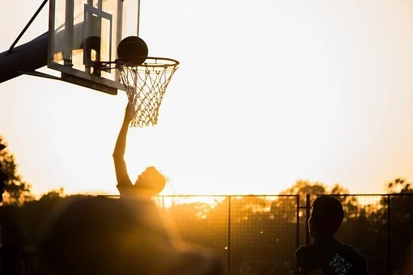
Unit 3 On the move
Developing ideas — writing

Slide 2
目录
I
Pre-writing
IV
Language points
II
While-writing
V
contents
Homework
III
Post-writing

Slide 3
I
Pre-writing

Slide 4

Pre-writing: reading & answering
Read the notice and post and answer the questions.
1. What kind of stories does the website want?
2. Why is the website looking for stories?
3. What information is included in Nick’s
story?

Slide 5
Pre-writing: reading & answering
Read the notice and post and answer the questions.
1. What kind of stories does the website want?
The website wants sports lovers’ stories from all over the world.
2. Why is the website looking for stories?
Because it wants to inspire its readers.

Slide 6
Pre-writing: reading & answering
Read the notice and post and answer the questions.
3. What information is included in Nick’s story?
The information included in Nick’s story is: what kind of sport Nick plays, how he got started with the sport, how he felt about the sport, what he’s done
to improve, and what he hopes to achieve
in the future.

Slide 7
Pre-writing: How to write a story?
introduction
(beginning)
a story
development
structure
climax (高潮)
narrative
(记叙文)
ending

Slide 8
Pre-writing: How to write a story?
1. Use time words (before, until, then, next, lastly, etc.) to make the sequence of events clear.
2. Use various adjectives (surprised, terrified, etc.) and adverbs (extremely, absolutely, etc.) to stress feelings and actions.
points to remember
3. Use different kinds of sentences like complex sentences to make the text more appealing.

Slide 9
II
While-writing

Slide 10
While-writing: reading and writing
Think of your own sports story and make notes.
Sport:____________________________
How you got started with the sport: _________________________________
How you feel about the sport: _________________________________
What you’ve done to improve:
_________________________________
What you hope to achieve in the future:
_________________________________

Slide 11
While-writing: reading and writing
Now write your own sports story. Use the expressions in the box to help you.
• When I was younger, …
• I never thought…
• The first time…
• Before I knew it, …
• Soon I found…

Slide 12
III
Post-writing

Slide 13

Post-writing: Presentation
Share your story with the class.

Slide 14
Post-writing: Evaluation
Questions | Your evaluation | Evaluator
Does the story include the key points? | 4 2 0
Is the story organized properly and smoothly? | 3 2 1
How is the language? | 12 8 4 2
How is the handwriting? | 3 1 -1
Paper design | 3 1 -1
TOTAL MARK

Slide 15
Post-writing: Reference text
I’ve been a sports nut since I was old enough to hold a ball. That’s why when my PE teacher presented me with the idea of joining the swimming team I decided to give it a shot and challenge myself a bit more. So I started going to swimming practice last June. At first I only regarded swimming as a hobby to enhance my
physical fitness. But soon I found I fell in love with it. Then, last week, I had my first swimming competition,
运动爱好者

Slide 16
Post-writing: Reference text
in the 100m breaststroke. Standing tall at the head of the lane made me feel both nervous and excited. After the sound of the whistle, I dived in and began to swim with all my strength! Finally, I came in third place. I was so happy for my achievement, and it proved that
hard work pays off. I will keep on swimming, perhaps for the rest of my life. Not only because it makes me healthier and stronger, but also for the confidence and sense of achievement it has brought.
蛙泳

Slide 17
IV
Language points

Slide 18
Language points
Find the following expressions and work out their meanings.
It made me feel like I could do…
be terrified of
deal with
persuade sb. to do sth.
这让我觉得我能够……对……感到惊恐；害怕
处理；应对
说服某人去做某事
_____________________________
_____________________________
_____________________________
_____________________________

Slide 19
V
Homework

Slide 20

Homework
Polish your story and hand it in.

